Slide 1
Albac Village, Romania
APPLICATION
2025 EDITION
BEST TOURISM VILLAGES BY UN TOURISM

Slide 2
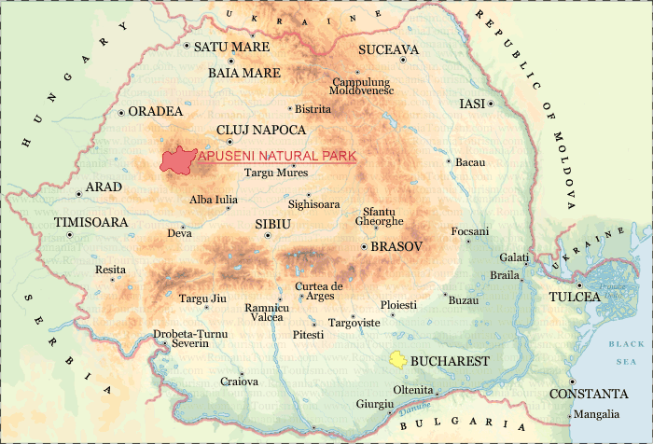
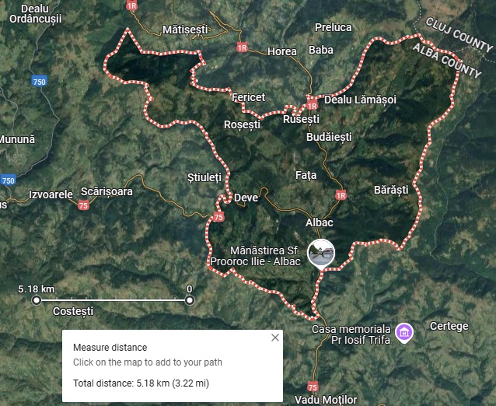
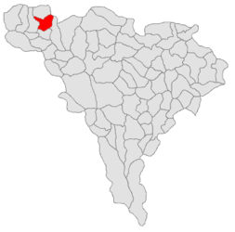
Where is the village Albac located in Romania
Apuseni Natural Park
National roads DN74 and DN75 are the main roads
Albac
Coordinates: 46°26′54″N 22°57′50″E
Alba County - Albac commune, coat of arms, location and boundaries

Slide 3
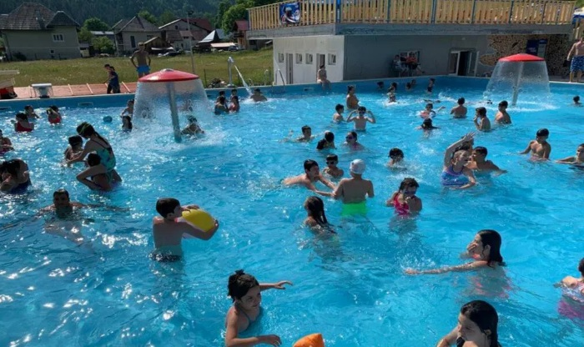
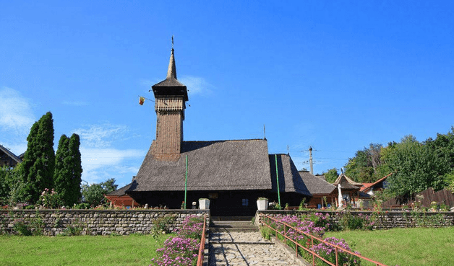
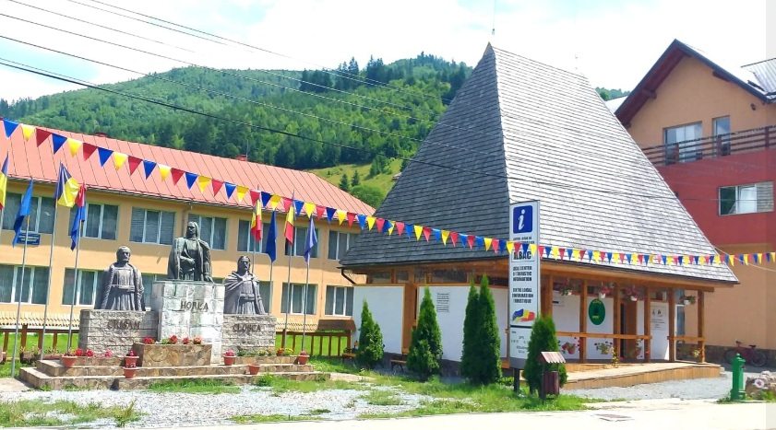
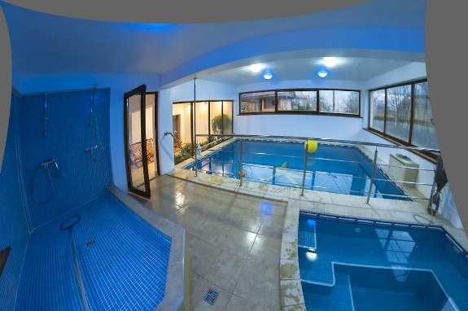
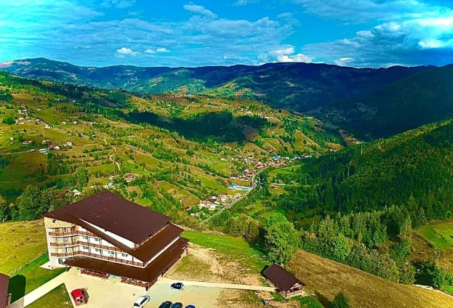
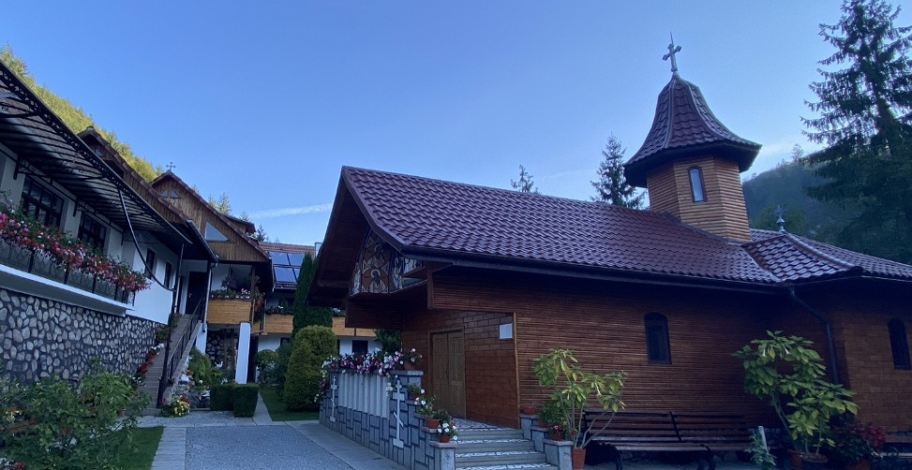
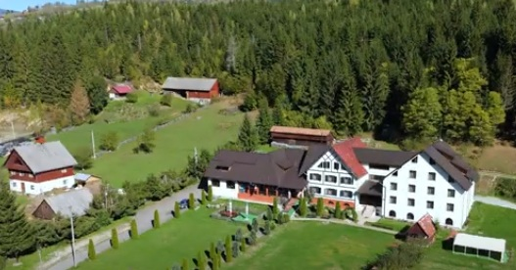
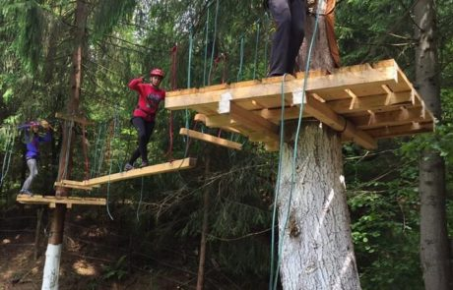
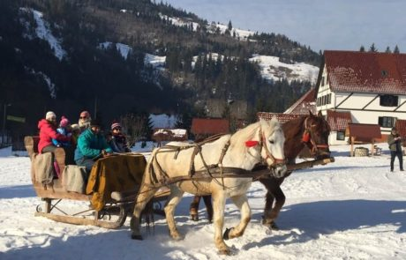
Getting to know about the Albac village
Tourists can swim in summer
in the mountains -700 altitude,in pools with water heated by solar panels and heat pumps
Modern constructions,
with traditional elements
in harmony with nature
The famous Horea Church
was saved at the beginning
of the 20th century and
moved to Olănești
The micro-regional tourist
information center,
traditionally built in
the style of Țării Moților
Indoor
swimming
pool
Saint Elijah Monastery,
traditionally built, intended for pilgrimages in the summer months
Spectacular hotel built
on a mountain peak,
for events and
school camps
Mansion built in a
mountain glade, for events
and school camps
Traditional
winter walks
Adventure park

Slide 4
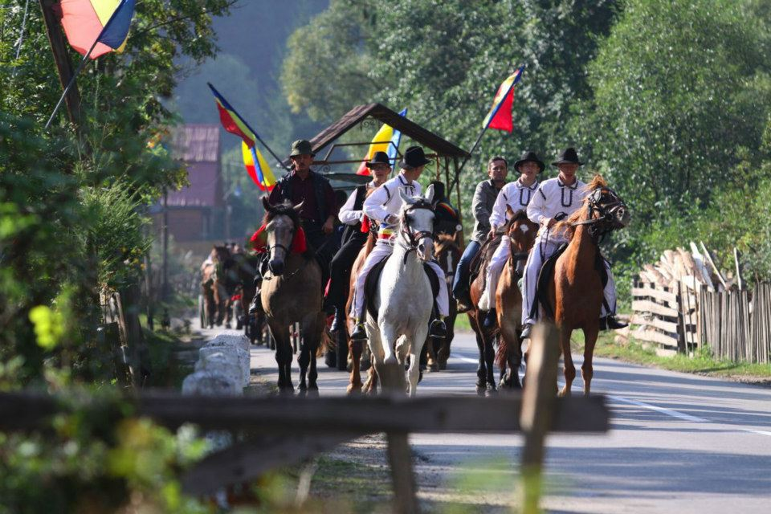
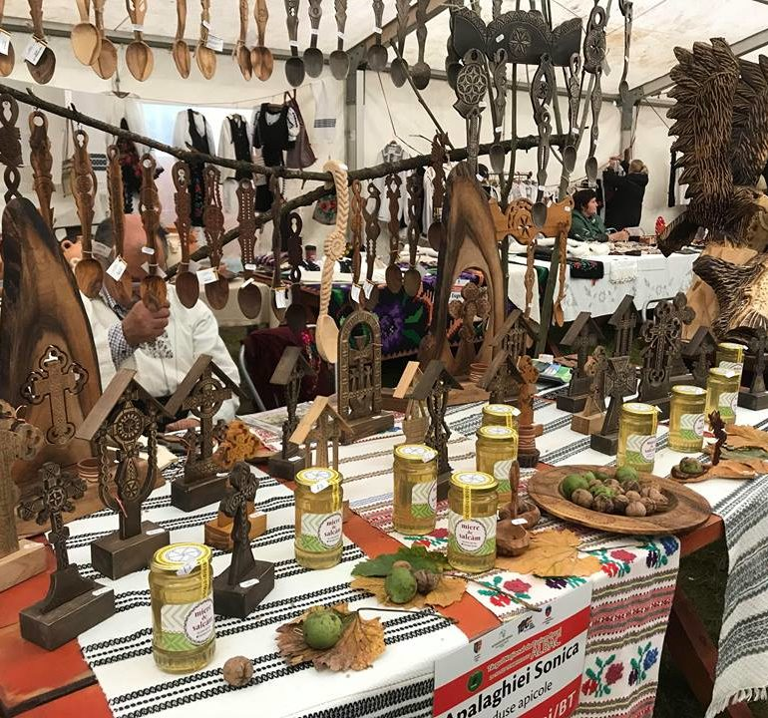
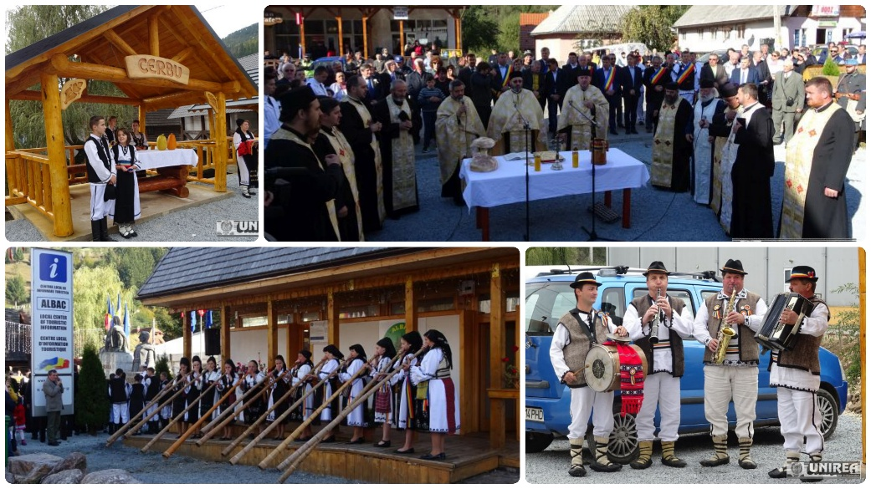
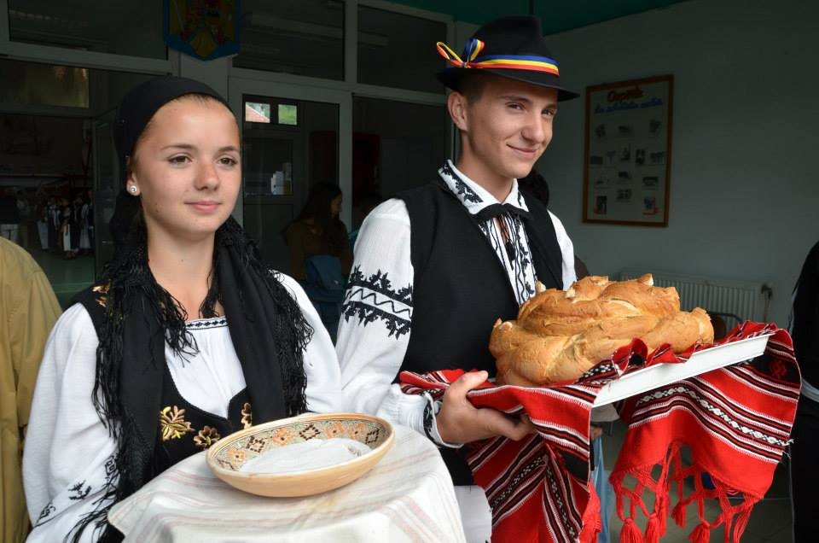
The most innovative initiative developed in Albac Village for tourism
The Albac Village is considered the Capital of Rural Tourism in the Land of Moti in the Apuseni Mountains
The National Rural Tourism Fair, the only fair in Romania traditionally organized by locals, which is transformed, amplified & dedicated exclusively to rural tourism

Slide 5
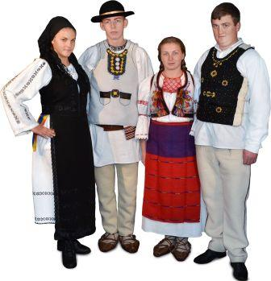
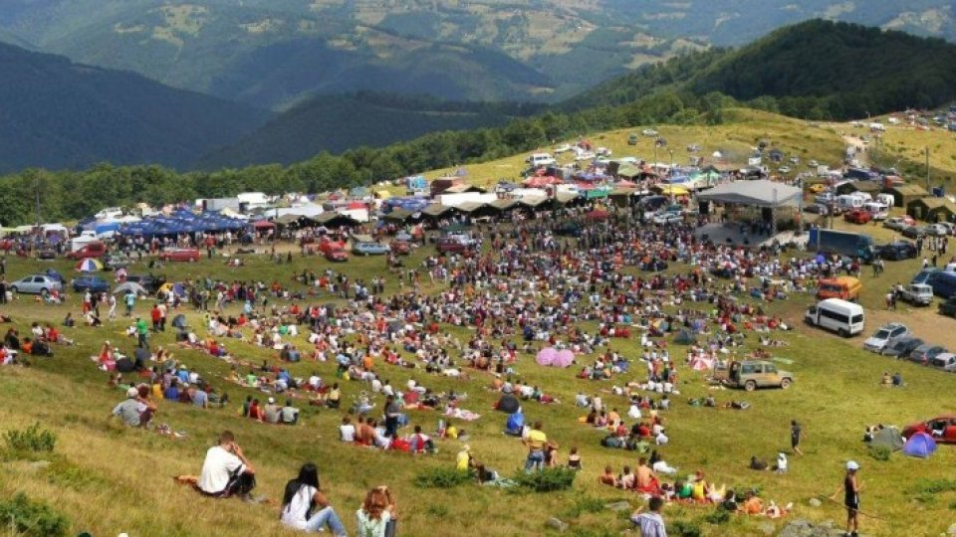
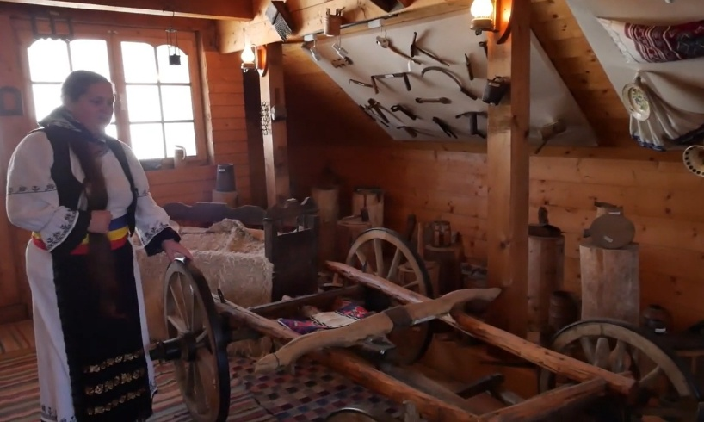
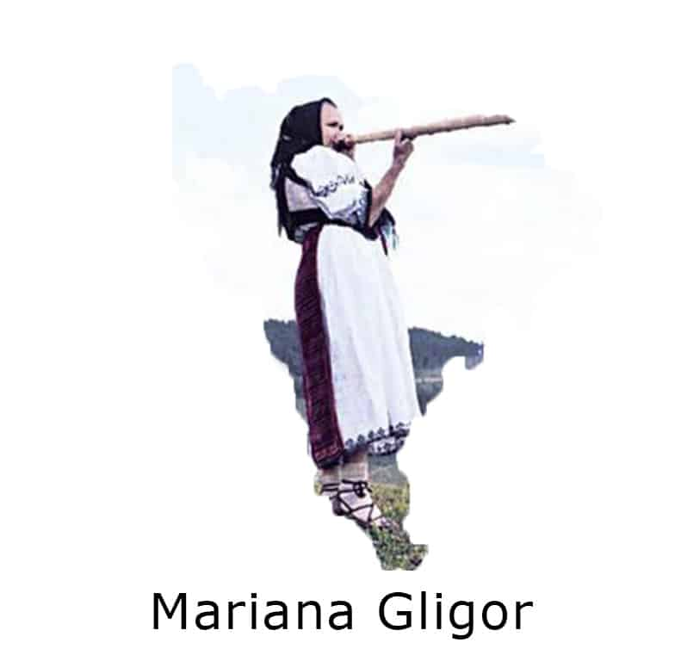
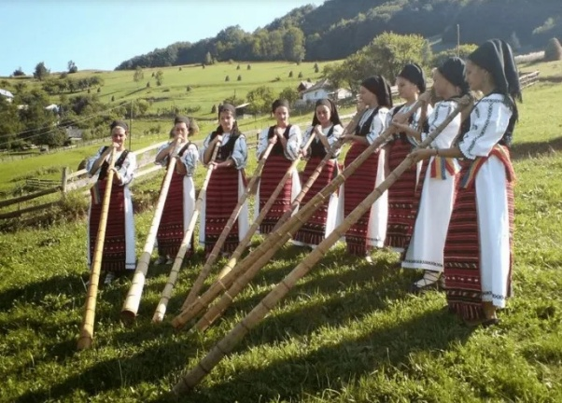
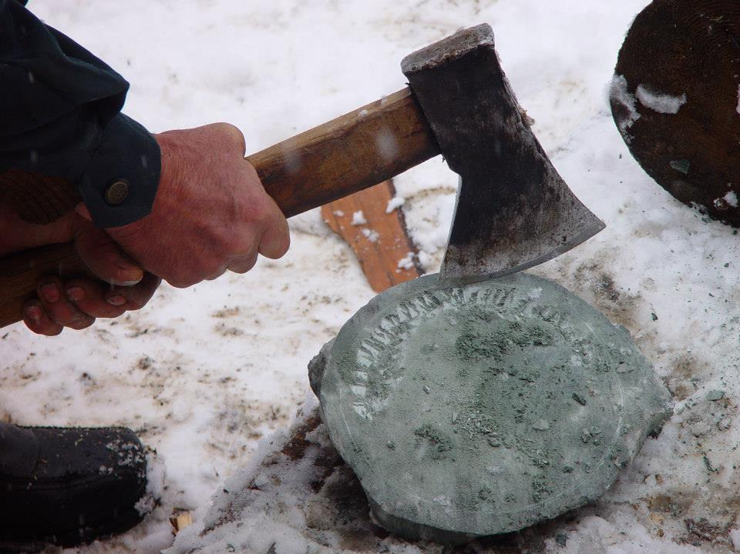
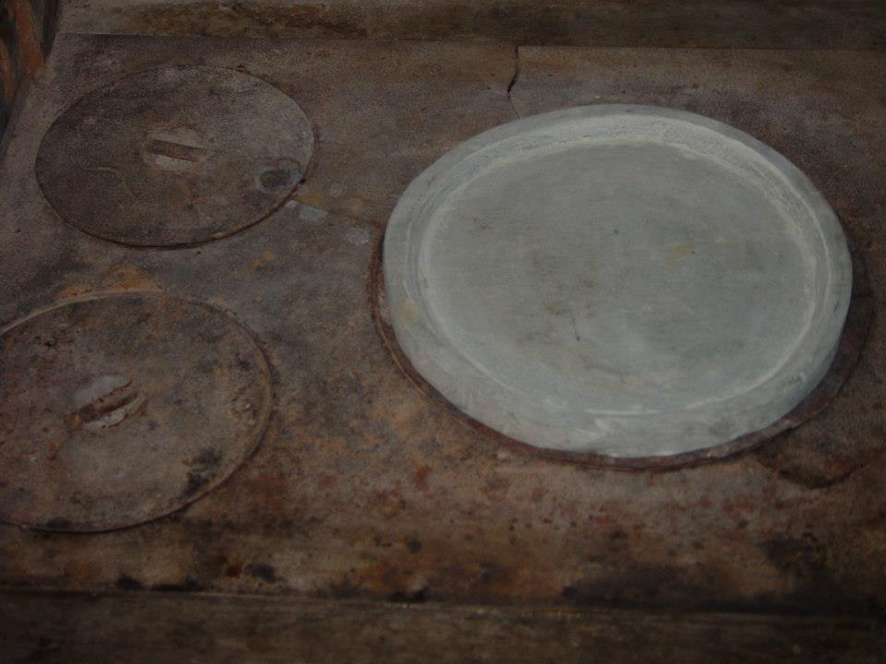
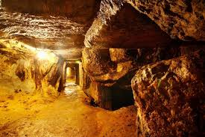
Cultural Resources and Conservation
Cultural resources are valued as a heritage by the inhabitants of Albac, whether it is the popular costume, crafts such as stone processing - even for cooking, wood processing for construction or wind instruments such as the tulnic, like a big flute without holes, but with rings
Living Human Treasure
The cultural resources preserved by the inhabitants of Albac meet one of the following criteria:
Associated with events that have made a significant contribution to the major pattern of Țara Moților history;
Associated with significant people of the Țara Moților past;
Embodies the distinctive characteristics of a type, period, or method of construction;
Has yielded or may likely yield information about the history or prehistory of
Țara Moților.

Slide 6
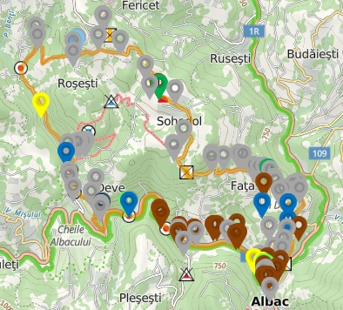
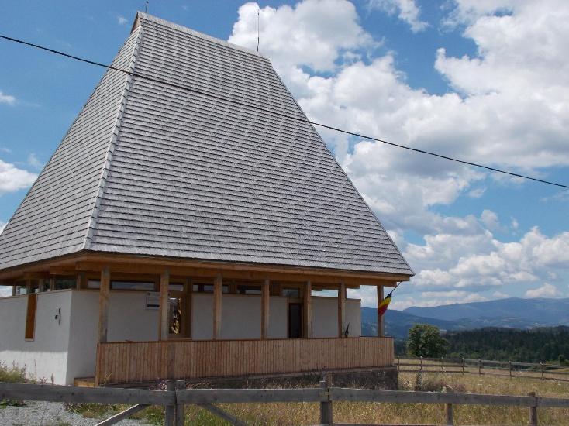
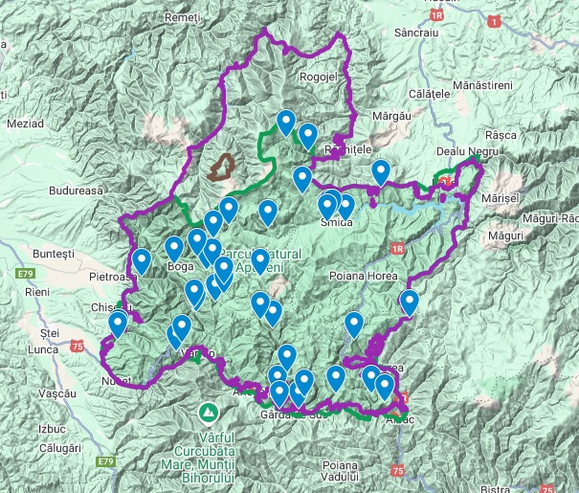
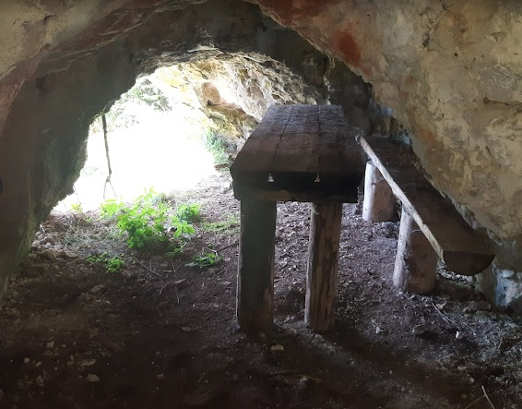
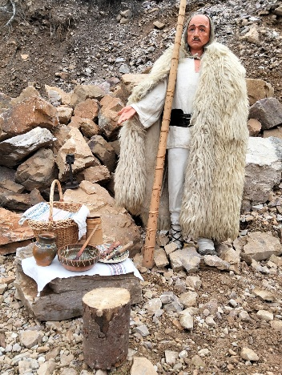
Natural Resources
Sohodol Refuge - built at 1,000 m altitude in traditional style, is included in the walking circuit of villages in Albac commune
The Apuseni Natural Park, of which Albac commune is part, offers us places full of charm and tranquility to reconnect with nature. The map of these places...
Albac
Milk Cave or Horea's Cave

Slide 7
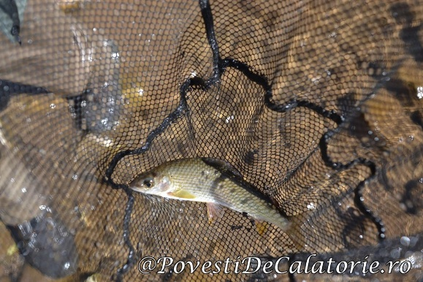
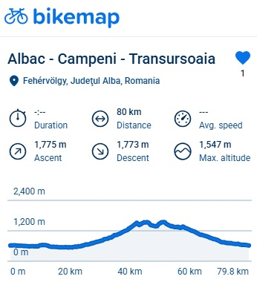
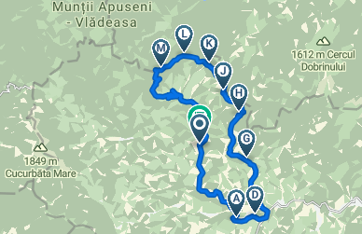
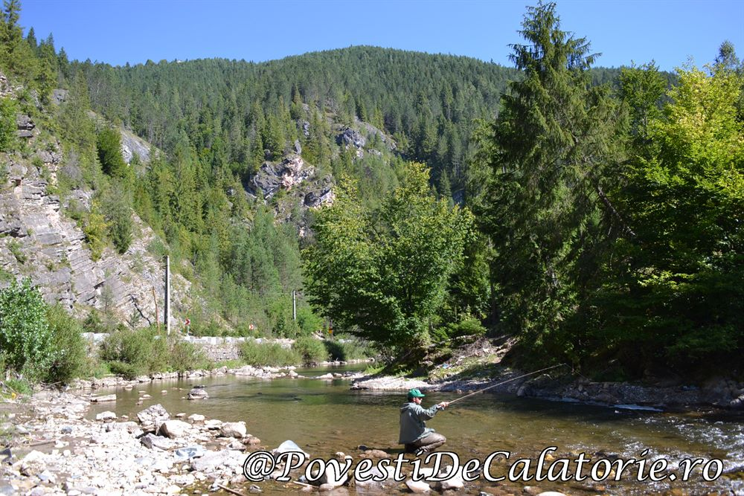
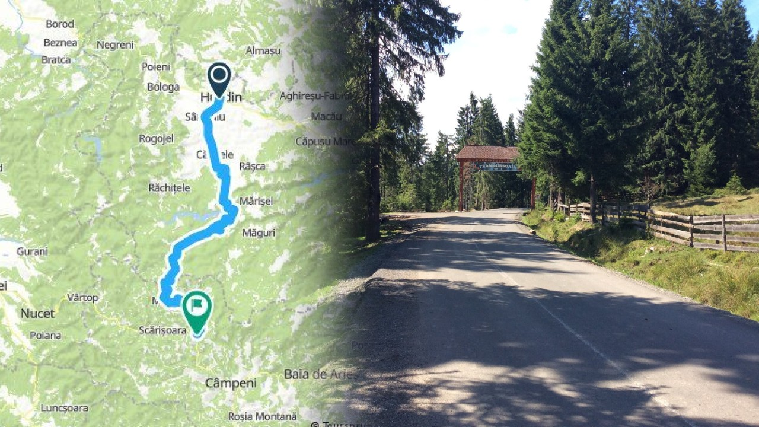
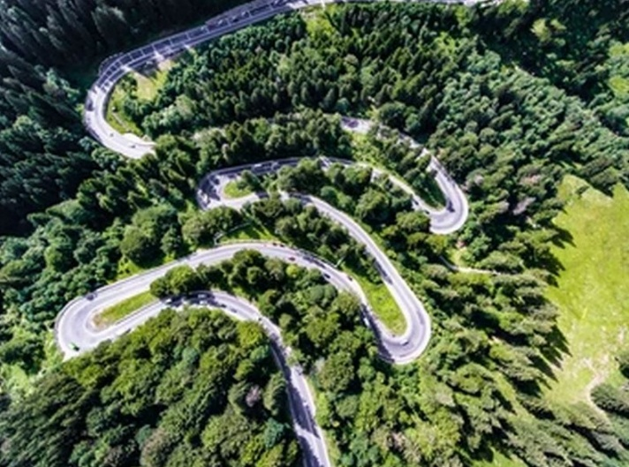
Sustainable use of natural resources
The remarkable Transursoaia road through narrow serpentines starts from the town of Albac, exits DN75 and climbs on 1R to an altitude of 1300 meters, then descends to Huedin, where it intersects with DN1.
Asphalted and over 80km long, the route challenges you to a fascinating journey through the heart of the mountains - by mountain bike or by car, offering breathtaking views.

Slide 8
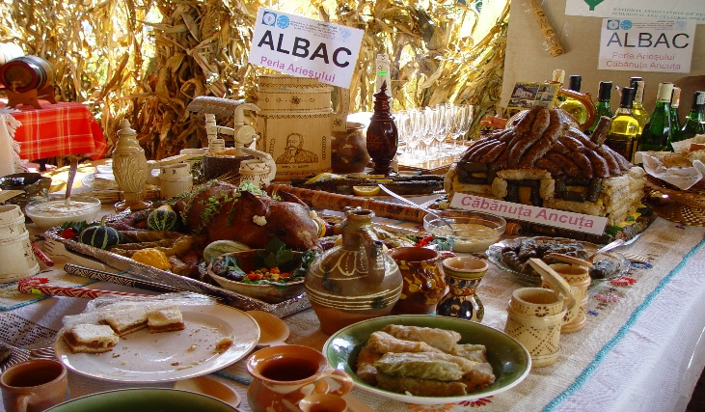
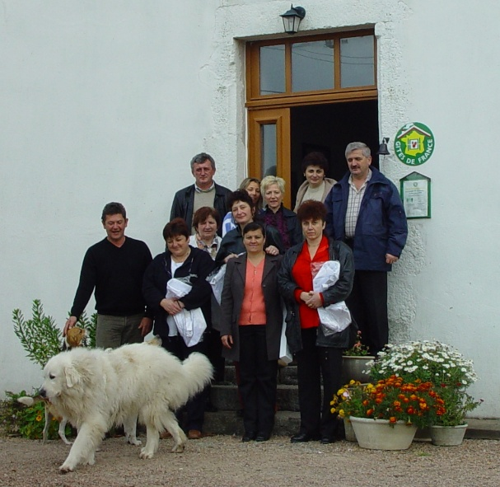
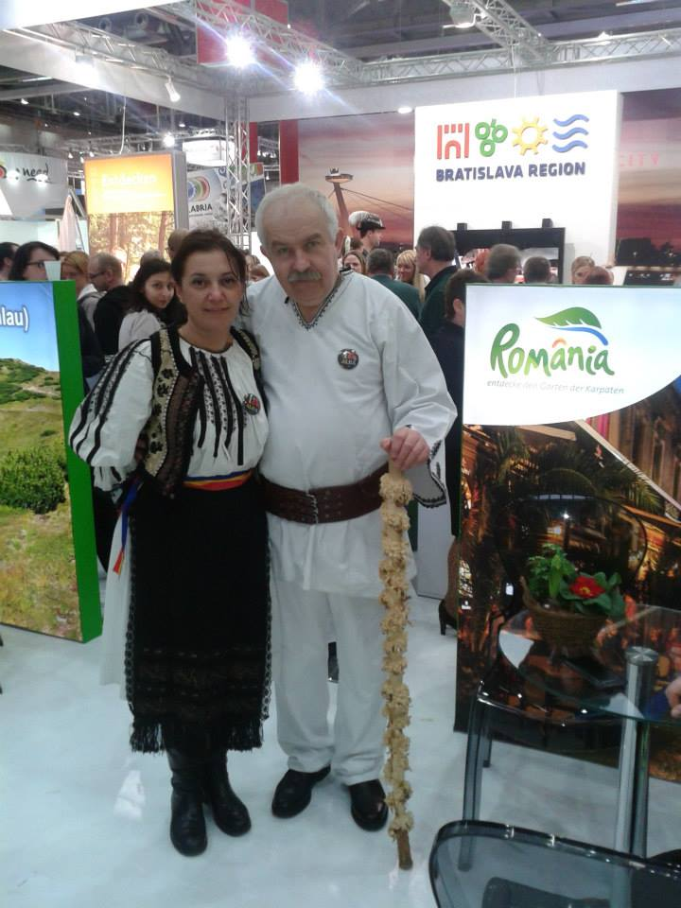
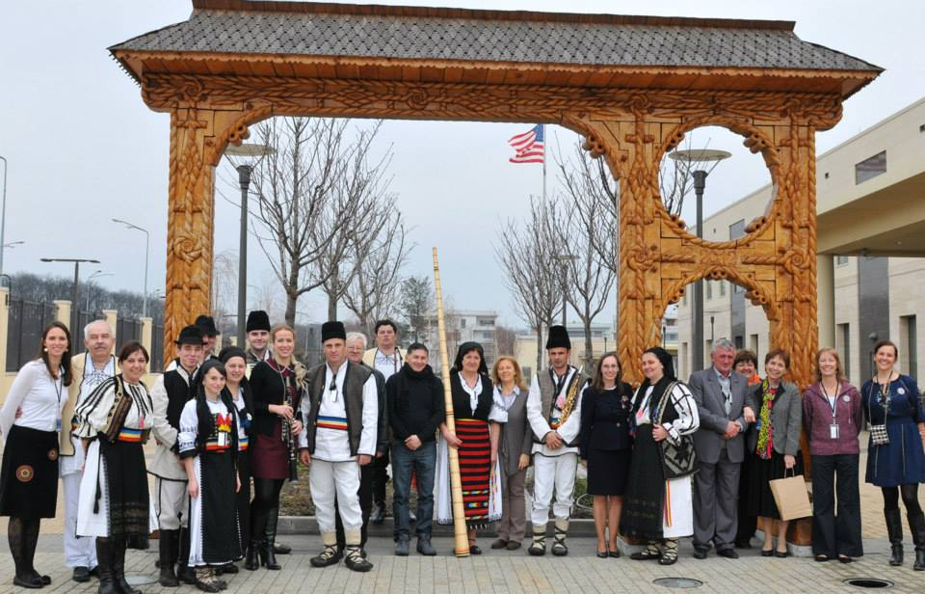
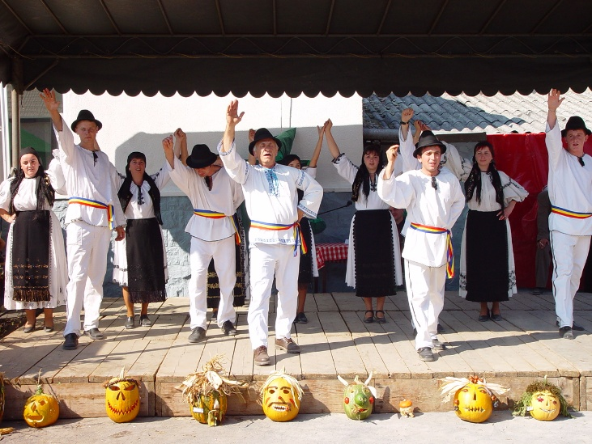
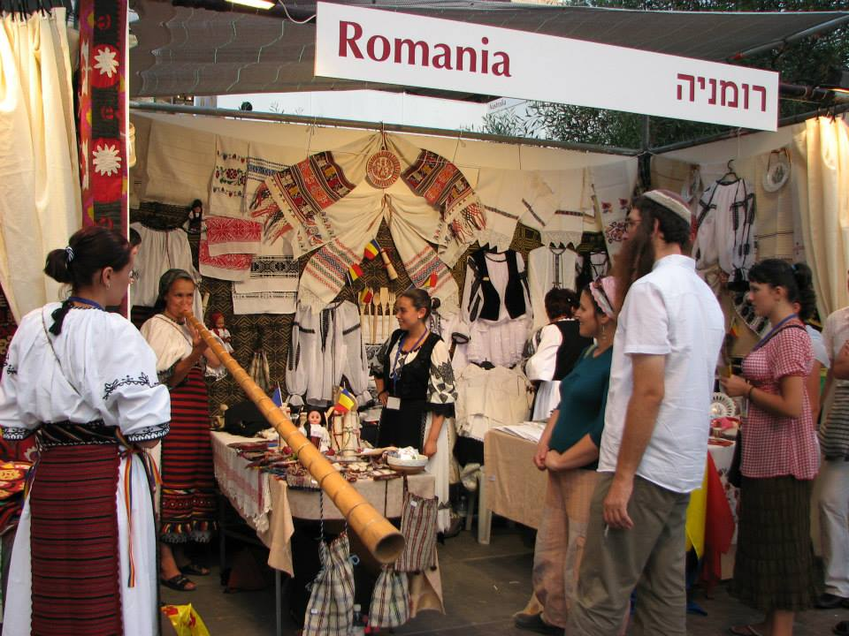
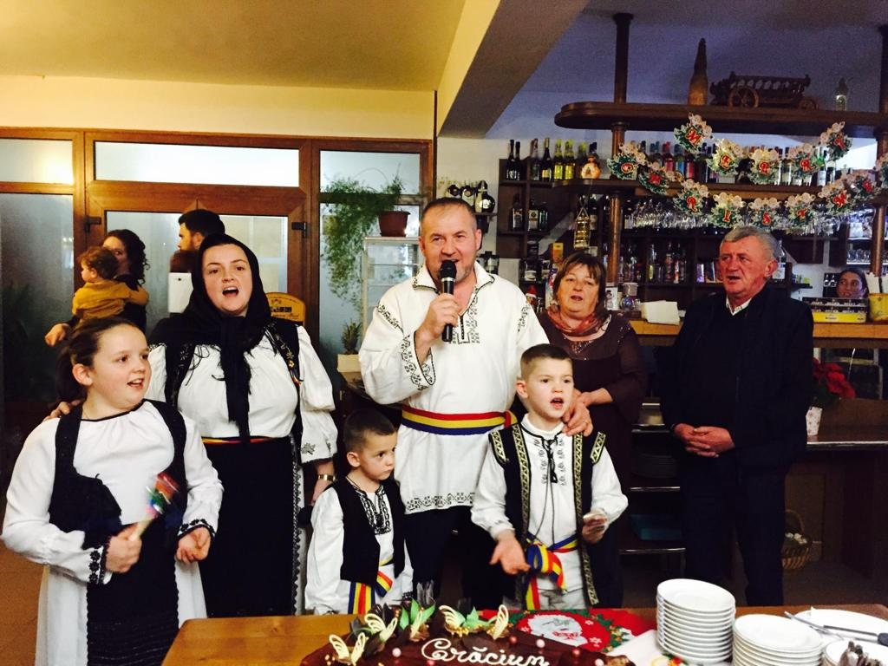
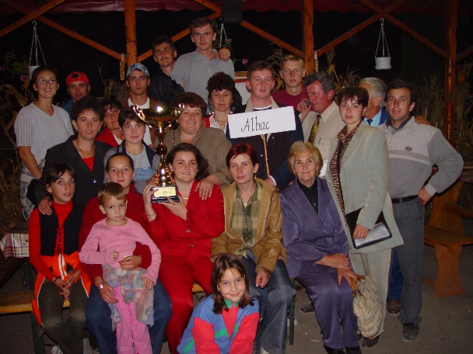
Promotion of Cultural Resources
The commitment of the inhabitants of Albac to the preservation of cultural heritage means the devotion to maintaining the authenticity of its historical landscape - Țara Moților
Domestic and international promotion, at tourism, arts and crafts fairs, gastronomic competitions etc. have brought numerous awards and distinctions, as well as increased visibility and tourist circulation...

Slide 9
Economic Sustainability
The increase in tourist traffic and accommodation capacity has led the inhabitants of Albac to seriously concern themselves with preservation, so as not to compromise the resources intended for future generations. Funds have been allocated or even accessed to support waste collection, at every house or parking space, even selective. Programs and partnerships have been developed, courses have been organized and a waste collection infrastructure has been built...

Slide 10
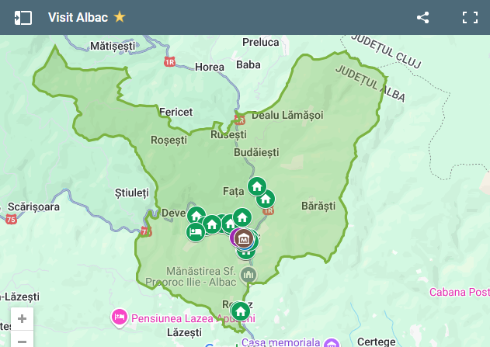
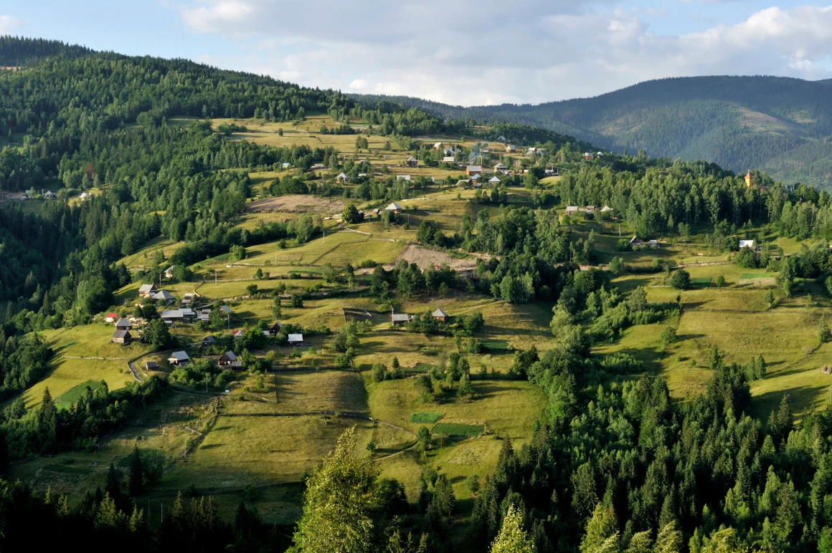
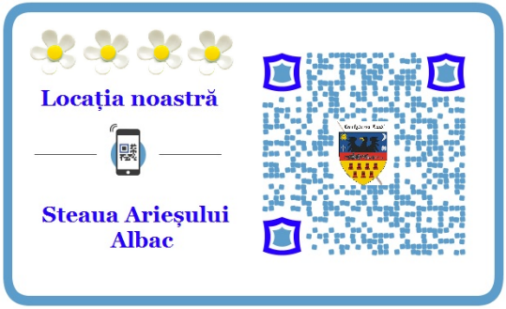
Tourism Development and Value Chain Integration
The theme for the 9th EDEN edition is
Health and well-being tourism.
Albac Village 2019, second place in Romania
CNN Best places in Europe to visit 2022. A modern-day Grand Tour, the Apuseni Mountains make for the ideal summer break
2020 - Albac is the first tourist resort in the Apuseni Mountains with digital localization of accommodation structures and tourist attractions
The inhabitants of Albac are the first in Apuseni Mountains, who standardize tourist programs in 2023, by developing Cultural Tourist Routes, according to European norms. These routes can be used by tour operators and tourists by downloading the information from the web, or even using NFC cards.

Slide 11
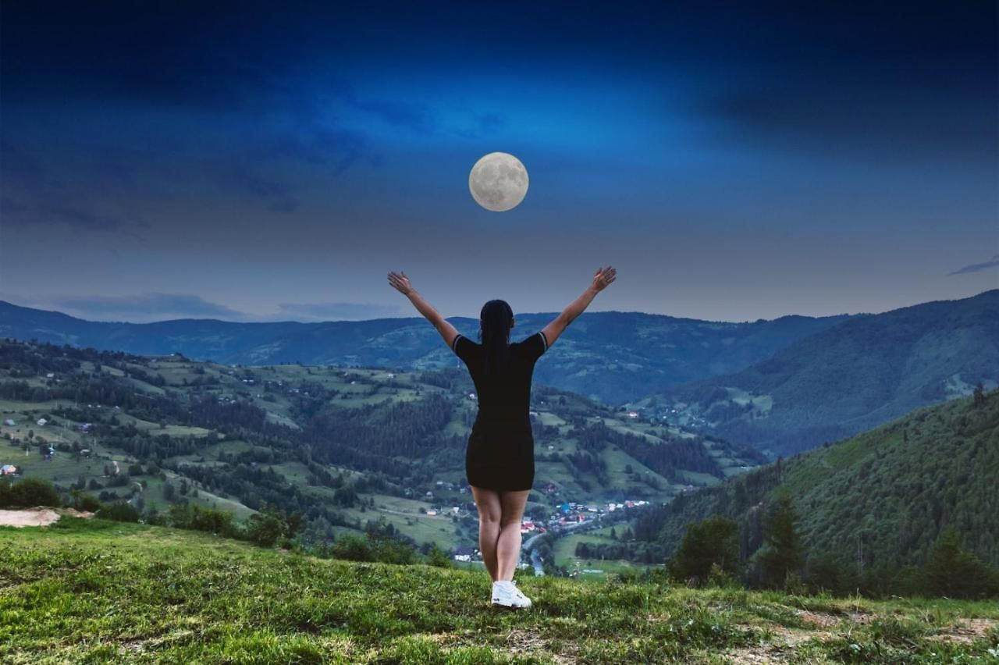
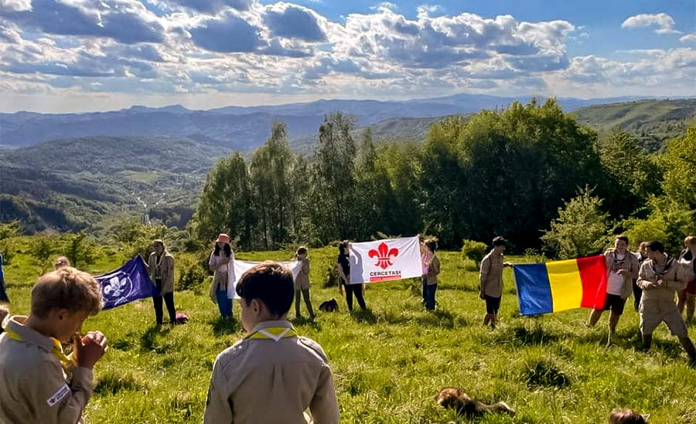
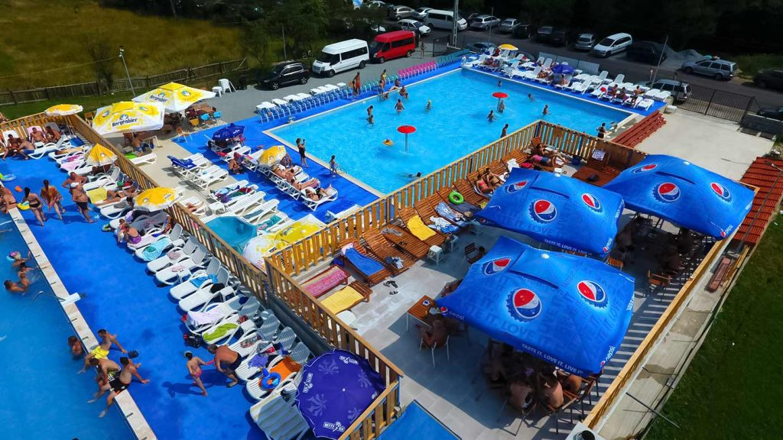
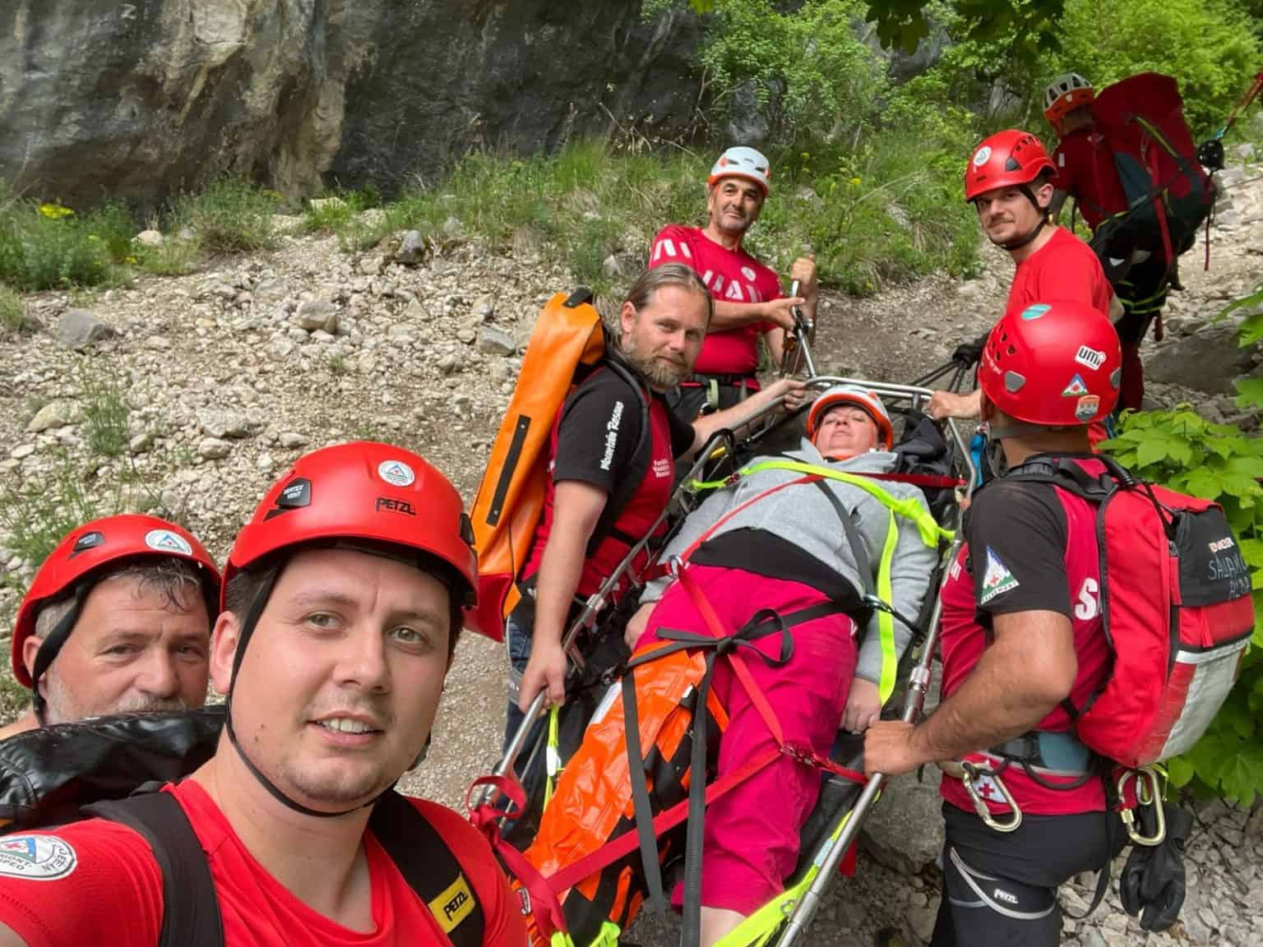
Health, Safety and Security
The inhabitants of Albac feel responsible, proud and happy to help and guide
In the center of the commune, in the village of Albac, there is 1 dispensary for medical emergencies and 2 pharmacies
Traditional food with homemade products and fruits picked from the forest

Slide 12
Albac Village, Romania
We are waiting for you, with love

